Slide 1
“The combination of ‘some data’ and an aching desire for an answer does not ensure that a reasonable answer can be extracted from a given body of data.”
John Tukey

Slide 2
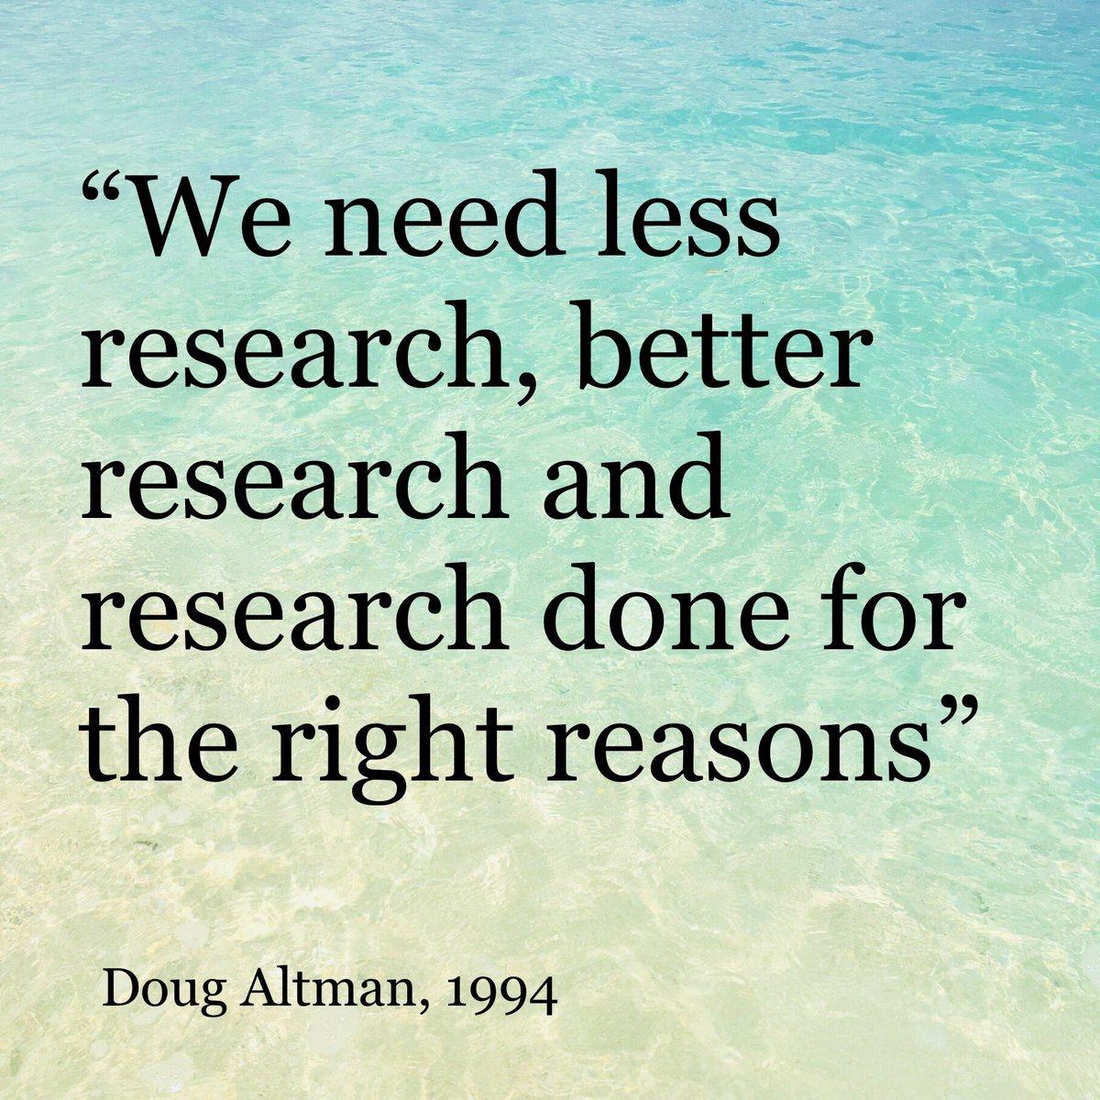

Slide 3
How many samples do I need?
George Savva (QIB) June 2024
Welcome – Please take handout

Slide 4
Introduction

Slide 5
Schedule (9.30 – 4.30)
1 – Revision – Statistical analysis and the importance of sample size
Break 11-11.15
2 – Calculating sample size needed (very simple designs)
Break 1-2
3 – Where do my inputs come from?
4 – Paired studies, cross-over designs, clustered data
Break 3.15-3.30
(5 – Genomics (studies with *many* outcomes))
6 – How to need fewer samples
Exercises and demos (using R) / lectures / discussion throughout.
Please interrupt with questions!
Please complete feedback questionnaire
Files – Slides – Exercises – Guide to power for microbiome studies

Slide 6
Learning objectives
What are:
Hypothesis testing and estimation
Revision of type I and type II errors
Sample size, power, false discovery rate
Understand:
The importance of having a large enough study
The principles behind sample size calculations
How to:
Use R (statistical software) for:
Identify, discover and interpret the inputs needed
Discuss:
How the principles above apply to more complex study designs
How to reduce the sample size required for a particular research objective
Other software for sample size calculations
Various common study designs.
Power, precision and sample size using simulation or analytic tools
Comparisons of means and proportions.

Slide 7
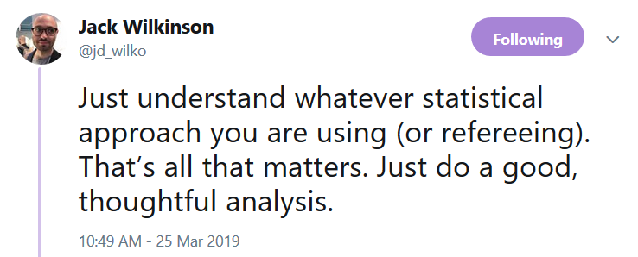

Slide 8
Welcome
Introduce yourself!
Which institute/group are you from?
What are you working on?
What kind of experiments do you do?
What brings you to this course?
How is sample size planning usually done in your area?

Slide 9
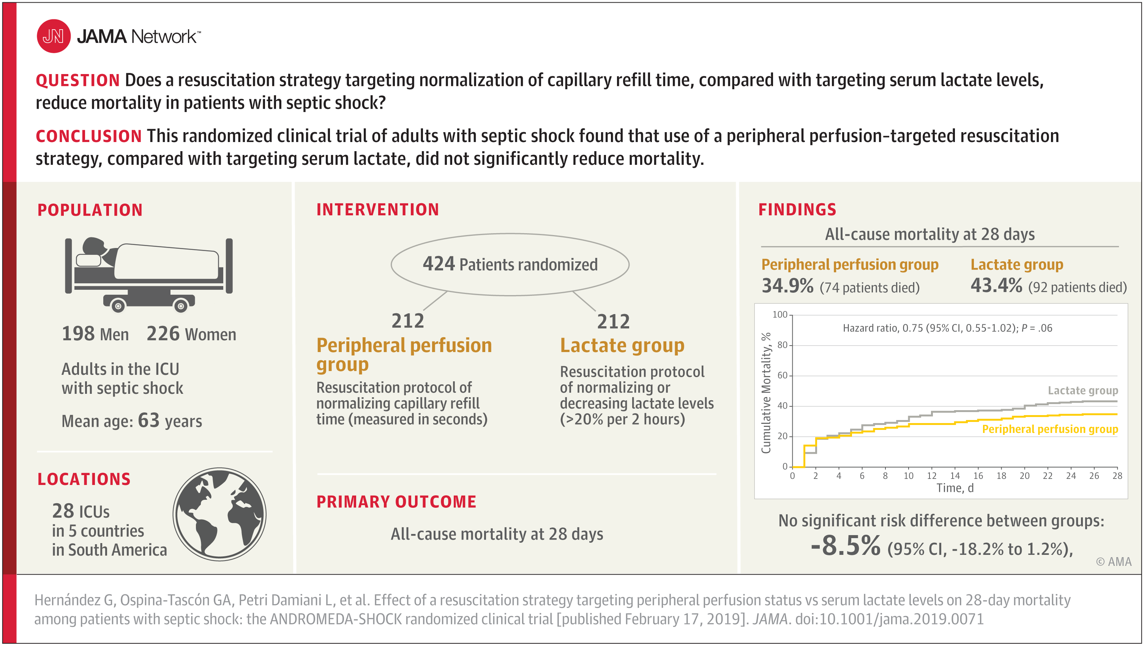
A recent study
Exercise 1

Slide 10
Session 1: Sample size, precision, and power

Slide 11

Most common question..
“….how many (animals/people/replicates) do I need in my study…”

Slide 12
Exercise 2 – (adapted from CoPS study) How many people with COVID have virus in their stool?
Research project:
Consecutive COVID patients will be recruited, we will test their stool samples for COVID virus and report the proportion of patients with detectable virus in their stool.
How many samples do we need?

Slide 13
Message
Sample size by simulation. The easiest(?) but maybe most effective way!
Simulate some realistic data
Conduct your planned analysis
Is your answer precise enough??
What did we need to know?
What exactly is our research question and our purpose
What does ‘realistic’ data look like
What analysis will we do?
This is not an exact science

Slide 14
What is the optimal sample size?
The smallest sample size that gives you a good chance of meeting your scientific objective.
There are different kinds of studies answering different kinds of question. Most (all?) can be expressed in terms of:
Hypothesis testing or (leading to a p-value)
estimation of a quantity (leading to an estimate and standard error)
(or both, there is a duality between these as we’ll see)
Hypothesis testing – sample size determined by power
For estimation – sample size determined by required precision
(exploratory, discovery, process control –can be thought as testing or estimation)
How good is good?
How much risk of failure are you willing to accept?

Slide 15
So what exactly is your scientific question?
The sample size question:
How many samples do I need….
……….to meet my scientific objective.
Ie to answer the question you set out to answer.
Two important things you need to know!
What is my scientific objective?
When will I know if I’ve met my objective
We want to describe the gut microbiome of older adults. How many samples do we need?
What is your research question?
To describe the gut microbiome of older adults
Can you be more specific…
What do you mean?
…..what exactly are you going to learn from your data…

Slide 16
“I want to describe the microbiome of older adults in Norfolk”
Bigger sample =
More precise answers to more questions
How will you determine when this objective is met?
What is the distribution of alpha/beta diversity?
Which are the most common species?
What is the prevalence of…? (How precise?)
How does diversity vary with age?
What is going on in specific sub-populations?
Which rare species do we find? (How rare?)
How do drugs affect species/diversity
Etc…
These questions must be specified to design your study.
Sometimes it’s not obvious and needs some work
Every questions needs a different analysis (possibly a different design) and a different sample size
Specifying the questions and the required precision:
A bit more work for you ☹

Slide 17
Make sure your calculation aligns with your real aims.
A group wanted to see if their dietary intervention affects alpha diversity of the gut microbiome
We calculated they would need 20 people
But then proposed to
Use machine learning to identify ‘responders’ to treatment
Do detailed comparisons of microbial compositions
Correlate microbiome with urinary metabolites
Etc…

Slide 18
Similarly
We want to test whether a treatment is effective (overall) in mice
The research plan suggests the investigators will also test for sex differences in the treatment effect (do male vs female mice respond differently)!
This is a different question and needs a different sample size calculation

Slide 19

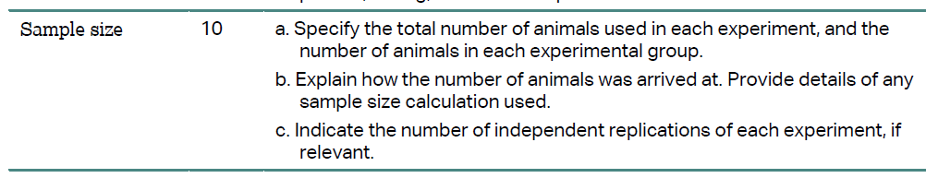
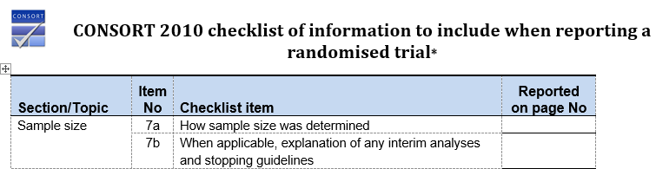
Purpose of a sample size calculation
Plan an efficient and effective study
Convince funders/ethics etc that your proposals are feasible
Reassure readers that your results are credible
Give you faith in interpreting your positive and negative results
Think through your analysis

Slide 20
Implications of low sample sizes
False negatives (obviously)
Because studies are too imprecise to see smaller effects
But also false positives!
The temptation / impact of fudging is higher
High rates of false positives in the literature
If most work is underpowered, then false positives become a higher proportion of all positives.

Slide 21
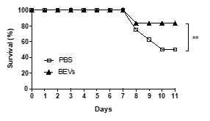
Hypothesis tests: Comparing two proportions.
Suppose we want to compare the rate of survival between a treated and an untreated group of mice
How many mice per group would we need?
Pilot Observation:
Treated: 1 in 6 died
Untreated: 4 in 8 died
How would you analyse this data?
How would we represent the treatment effect?
Do you think the treatment ‘works’?
Published in a recent paper
P<0.01

Slide 22
Worked example (exercise 3) – Bread study / Sample size by simulation
Estimate the effect of a new type of bread compared to standard white bread on glycaemia (blood glucose).
First, I’ll run a preliminary study of the intervention, to illustrate the effect of sample size on precision of estimates and reliability of p-values.
Then we’ll consider how many participants we need.

Slide 23
Discussion points
How precise was the estimate of treatment effect with 10 participants?
How did this change with increasing sample size?
How reliable was the p-value across repeated experiments?
Did the experiments agree or disagree regarding the efficacy of the new bread?
How many samples was ‘enough’?

Slide 24
Exercise 4. Power (check our understanding)
What is statistical power?
What does it mean if an experiment has a power of, say, 80%?
What is an ‘under-powered’ study?
What are the consequences of an underpowered study?
Immediate?
Wider?

Slide 25
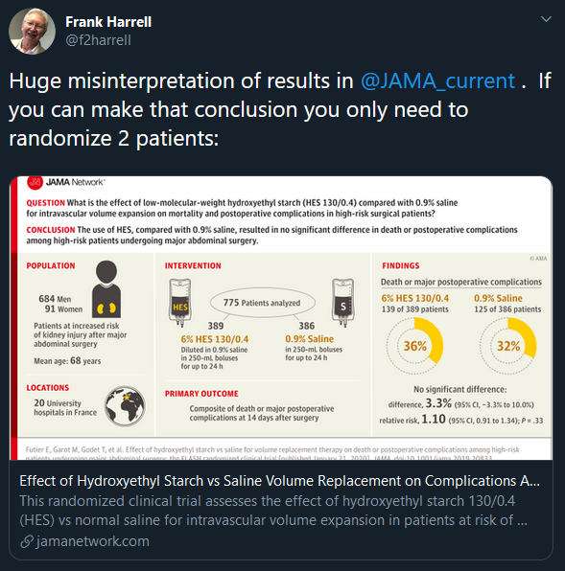
Another poor interpretation
This mistake is made every day in biomedical journals.
Danger of real harm or promising interventions abandoned.

Slide 26
Exercise 5 Why do scientists ignore sample size issues?
Because this is the typical logic:
Do experiment
Do analysis
If p>0.05 – we have proved there is no effect,
if p<0.05 – we have proved there is an effect
What’s wrong with this logic? Can you correct it?

Slide 27
Hypothesis testing and types of error
For any given experiment: The null hypothesis is either true or false.
If the null hypothesis is true (no effect)
You might get a false positive (type I error – Prob=size of the experiment)
You might get a true negative
If the null hypothesis is false (there is a real effect)
You might get a true positive (Prob = power of the experiment)
You might get a false negative (type II error)
Remember: experimental results are random.

Slide 28
Power and size (typical values)
Power of 80%:
“If the effect is there, then my experiment has an 80% chance of detecting it (as statistically significant)”
Perhaps better: “I have a 20% chance of missing a real effect”
Size of 5%:
“If the effect is not there, then my experiment has a 5% chance of reporting a (false) positive”
How do we set the size of an experiment?
We fix the size by setting the critical p-value (usually p<0.05) for our analysis

Slide 29

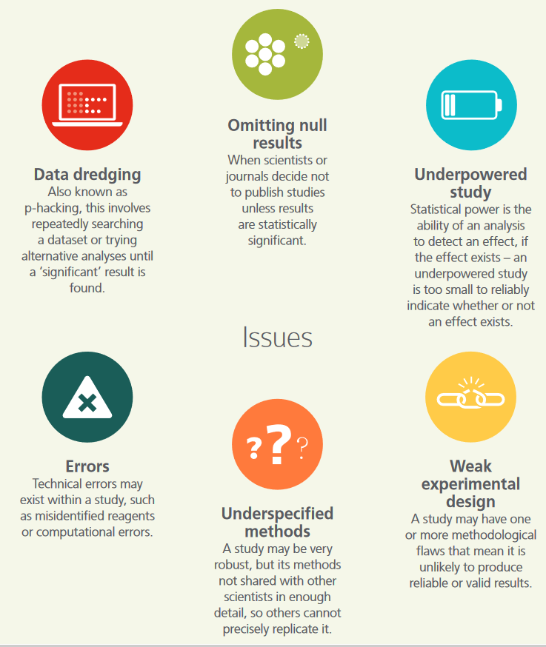
Funders scientific integrity review

Slide 30

…what about ‘exploratory’ research
It’s OK, it’s only an exploratory study
When do you need a sample size calculation?
When don’t you need a sample size calculation?
You should always have a good rationale for your sample size
What is the purpose of exploratory research?
To my mind exploratory research should be sensitive.
What’s the point of screening for associations if you’re going to miss most of them?
Thoughts?

Slide 31
….what about feasibility / pilot / proof of concept studies?
What is the aim of a pilot study?
Get estimates for reliability and variation
Test feasibility of protocols
Get initial estimates for effect size
Screen out ‘useless’ interventions
Show change in a proximal biomarker
Get preliminary data for grant application
Usually not to demonstrate something conclusively
Make sure your study is designed to meet its own objectives
May not need a power calc but does need a rationale for sample size.
Have you conducted a pilot study?
What did you learn from it?
Did you meet your objectives?

Slide 32
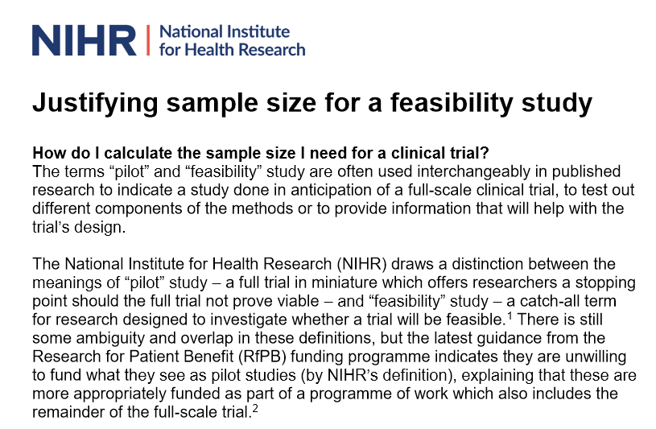
Why is N=30 (total) considered a reasonable number for a feasibility study?
https://www.rds-london.nihr.ac.uk/wpcms/wp-content/uploads/2019/02/Justifying-sample-size-for-feasibility-study-updated-22-Feb-2019.pdf
What are the goals of a feasibility study?
N=30 is:
Reasonable for estimating a proportion
Reasonable for estimating a standard deviation

Slide 33
Summary 1 : what is statistical power?
Power is the probability that your experiment will demonstrate an effect when it is really there. (the ‘sensitivity’ of your experiment).
With an underpowered study:
More chance of missing real effects ( type II error prob = I - power)
More chance that your ‘discoveries’ are false!
(because the rate of false positives stays constant at 5%)
Underpowered studies are often worse than useless (kill a good idea, or generate noise, often uninterpretable).
Exploratory and confirmatory studies should be designed to meet their own objectives

Slide 34
Summary 2: Required sample size
The sample size we need is the smallest number that gives us a good chance of answering our research question well enough.
(This might be an estimation or a testing question)
Simulation is a very good way to see how our results are likely to vary with sample size!

Slide 35
Part 2: Calculating required sample size for simple designs

Slide 36
Revision – quant research paradigms
All quant research aims to estimate something or test hypotheses
Can you state the objective of the ANDROMEDA-SHOCK trial in terms of estimation and testing?
Estimate: What is the relative risk of death associated with new intervention compared to old.
Test: Does the new intervention save more lives than the old one.
Can you state the objectives of the breads study in terms of estimation and testing?
Which is the better research framework?

Slide 37
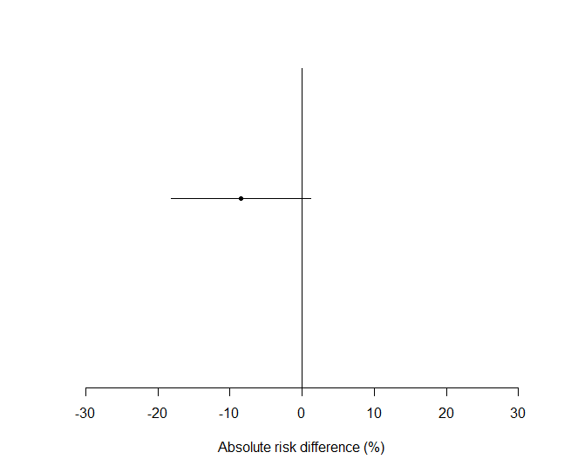
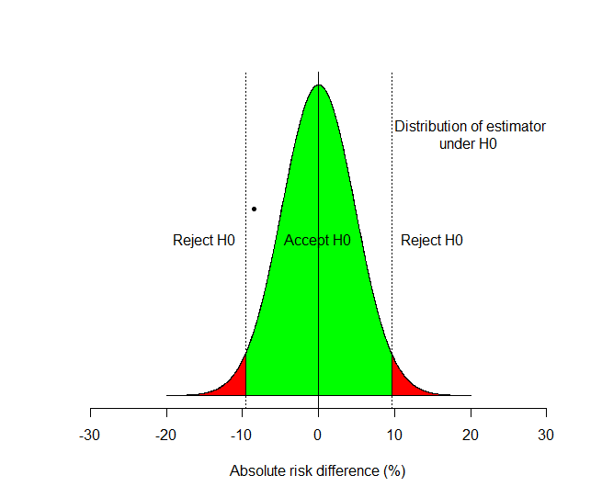
ANDROMEDA-SHOCK trial (results)
Estimate plus confidence interval (and free hypothesis test!)
Hypothesis test:
Note there is a smallest detectable effect size
P=0.06
95% CI = -18.2 to 1.2
Which is the most informative?
What will be the effect of increasing sample size on each picture?

Slide 38
Two paradigms for inference -> Two approaches to sample size calculation:
Based on power:
From ‘hypothesis testing’ paradigm
“eg if this effect is real then I want to be at least 80% sure that I won’t miss it at p<0.05”
Based on precision:
From ‘estimation’ paradigm, eg:
“I would like my standard error to be less than 0.25 units”

Slide 39
Sample size by considering precision

Slide 40
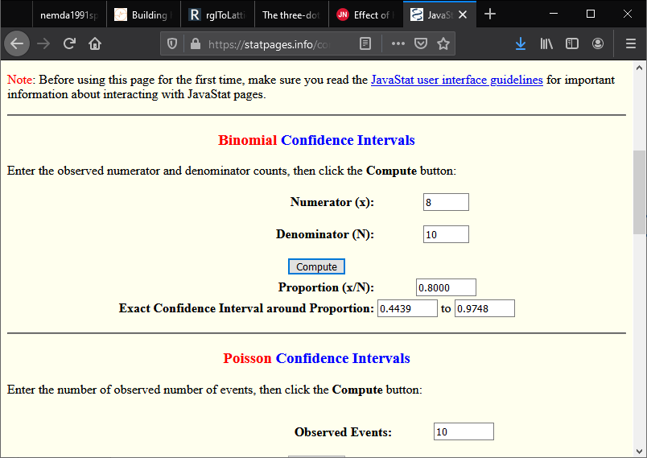
Exercise 4 – To estimate a proportion
Precision as a function of sample size.
https://statpages.info/confint.html
Or
R> binom.test(2,10)
Exercise:
Suppose I want to estimate the likely Liberal Democrat vote share in the general election to within 2 percentage points.
How many people do I need to sample?

Slide 41
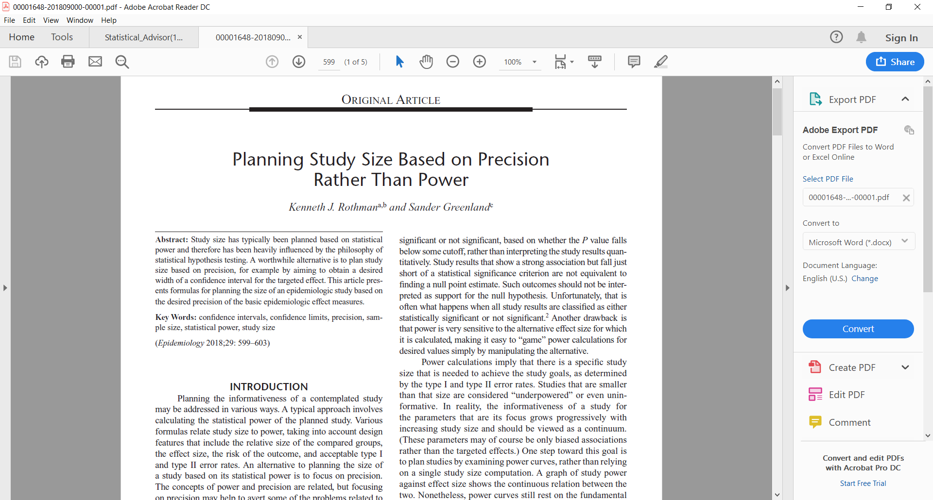
A relatively new idea (2018)
But very simple
As we move away from hypothesis tests, this will become more common

Slide 42
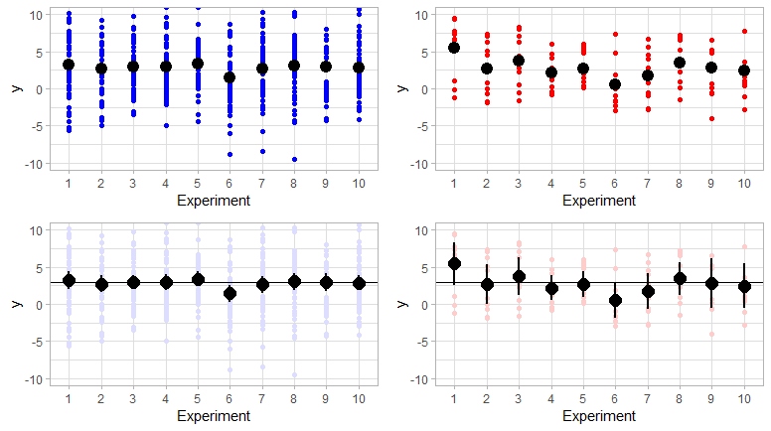
Standard error, standard deviation, sample size

Slide 43

How does precision depend on sample size?
Each time we run an experiment we will get a different estimate
Hence, estimators are random.
Their standard deviation is called: standard error
Standard error reflects the precision of our estimate
Reflects how sure we are about where the truth is.
Confidence interval can be easily generated from this.
If data points vary independently with standard deviation s, then sample mean has variance:
If an estimator is (roughly) normally distributed then 95% confidence interval includes all points within twice the standard error of the point estimate:
${se}_{mean}$ $=\frac{sd}{\sqrt{n}}$
$$95\% CI=b ±2×se$$

Slide 44
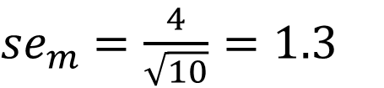
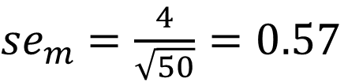
Standard error, standard deviation, sample size
S.d. = 4
N = 50
S.d. = 4
N = 10
${se}_{m}$ $=\frac{4}{\sqrt{50}}=0.57$
${se}_{m}$ $=\frac{4}{\sqrt{10}}=1.3$
Width of 95% CI ~ 4*0.57 = 2.3
Width of 95% CI ~ 4*1.3 = 5.2

Slide 45
Sample size calculation based on precision
This leads us to a simple way to calculate sample size:
Worked example (to estimate a mean):
Suppose we want estimate of mean test bread iAUC
We want to estimate it to within approx ±20 GI units
How many participants will we need?
How should we approach this question?
What other information do we need?
Things we need to know:
What level of confidence? (assume 95%)
What is the standard deviation of the outcome measure (s.d. of iAUC ~ 60)

Slide 46
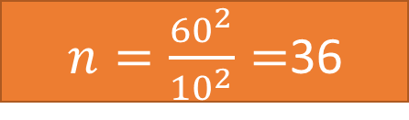
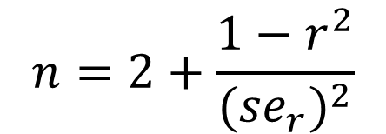
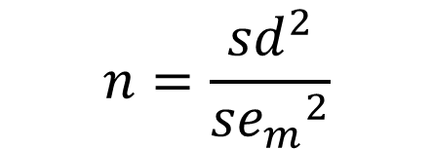
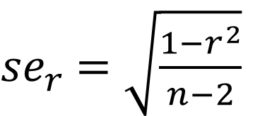
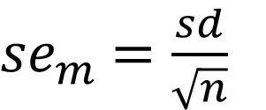
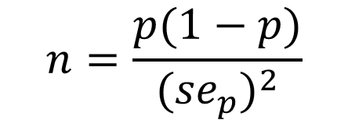
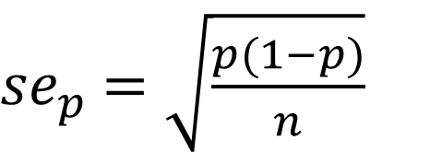
Standard error to estimate proportions, correlations, and means
Standard error for a mean, where the standard deviation is sd:
Standard error for a proportion (p):
Standard error for a correlation (r):
${se}_{p}$ $=\sqrt{\frac{p(1−p)}{n}}$
${se}_{r}$ $=\sqrt{\frac{1−r^{2}}{n−2}}$
${se}_{m}$ $=\frac{sd}{\sqrt{n}}$
$$n=\frac{{sd}^{2}}{{{se}_{m}}^{2}}$$
$$n=\frac{p(1−p)}{{{(se}_{p})}^{2}}$$
$$n=2+\frac{1−r^{2}}{{{(se}_{r})}^{2}}$$
$n=\frac{{60}^{2}}{{10}^{2}}=$36
Note that sample size is roughly inversely proportional to se squared
Similar formulae exist for mean differences, relative risks, risk differences etc. You can look these up – Many are in Greenland and Rothman (2018).

Slide 47
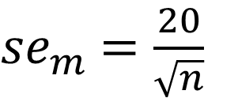
Precision vs sample size (estimating the mean in a single sample)
Note diminishing returns!
To get the standard error down to about 2.5, we will need about 64 patients
To get the standard error to 5 we only need 16 patients
${se}_{m}$ $=\frac{20}{\sqrt{n}}$
Remember: the width of a 95% CI is about 4 times the standard error

Slide 48

Precision vs sample size (estimating a correlation)
Suppose we want to estimate the correlation between brain health and gut microbial diversity
Expected to be about 0.3, we would like +- 0.1
How many participants do we need?
To halve the standard error, I will need ~4 times as many samples!
$$n=2+\frac{1−r^{2}}{{{(se}_{r})}^{2}}$$

Slide 49
Sample size by precision
Decide how precise you need your estimate to be
Work out how standard error depends on N (look it up!)
For your study design and outcome measure
For a mean, you need to know the likely variation in your outcome measure
For a proportion or a correlation, you need some idea what it might be
Solve for N!

Slide 50
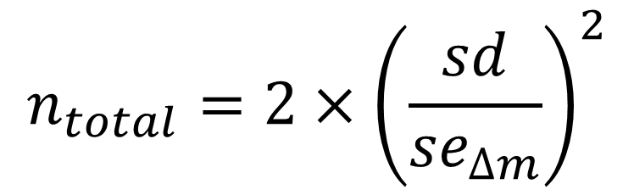
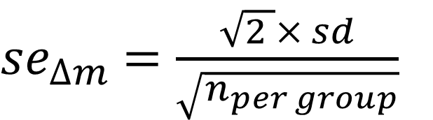
Example: Sample size for a mean difference
Example:
Now we want to estimate the difference in iAUC between the test and a control bread, using a two-arm parallel groups study
We will estimate this by the difference in means between groups
How many participants will we need to estimate the difference to within ± 20 units?
What is the standard error of a mean difference between two groups?
To estimate difference to within ±20, with 95% CI, assuming SD of 60.
${se}_{∆m}$ $=\frac{\sqrt{2 }× sd}{\sqrt{n_{per group}}}$
$$n_{total}=2×{\left(\frac{sd}{{se}_{∆m}}\right)}^{2}$$

Slide 51
‘precisely’ package for R
Base R can be supplemented by ‘packages’ to do almost any analysis.
If somebody has ever needed to do anything (statistical)…
… there is probably an R package for it.
Precisely can estimate sample size based on precision for odds ratios, rate ratios, risk differences etc. Based on Greenland and Rothman (2018). Although the formulas aren’t too complex.
https://github.com/malcolmbarrett/precisely (R package)
https://malcolmbarrett.shinyapps.io/precisely/ (Shiny app)

Slide 52
Exercise 6 – (RESTORE-ME) study
Suppose we are planning a trial of FMT (fecal microbial transplant) for ME/CFS
We will use a 2 group trial, with remission (binary outcome) as an outcome.
We expect the baseline rate to be about 20%, and the treated rate about 40%.
We would like to estimate the difference in remission rates to within +10%
How many samples do we need?
Hint: formula for a standard error of difference in proportions or use Precisely website.
The PI says this is absurd and he can only recruit 15 participants per group. How precise will his estimate be (on average)?
What should we do?

Slide 53
Part 2 Sample size by considering power

Slide 54
Sample size by power calculation
With the “hypothesis testing” paradigm (using p-values for inference)
The power of a study is the probability that:
you will detect an effect as (statistically significant)
if it is really there
This is the same as the probability that the 95% CI will exclude 0
What factors does power depend on?
(or whatever value means no effect).

Slide 55
What determines statistical power
Bread study simulation:
For a given study, power depends on:
Precision of experiment (standard error of the outcome)
In turn depends on precision of outcome measures (standard deviation) and sample size.
Size of the effect we are looking for
Precise (large) studies can detect small effects.
Imprecise (small) studies can only detect big effects.
https://georgemsavva.shinyapps.io/powerSimulator/?_ga=2.34107425.1699691659.1643060404-707910651.1642944081

Slide 56
So any statement about power must depend on the size of the effect you are trying to detect.
E.g. To detect an effect of a weight loss intervention..
If it is going to cause a 10kg loss on average, then I might need very few people
If it is going to cause a 100g loss on average then I will need many more people.
Which effect size should I choose for my calculation?
Turns out a weight loss intervention is only valuable if people lose 3kg or more.

Slide 57
If you’re still not happy with this
Consider testing difference in average heights between:
Adults (~168cm) and Ten year old children (~138cm)
Men (~175cm) and women (~161cm)
Dutch men (~183cm) and English men (~179cm)
Required sample size depends enormously on the real underlying effect size!
(Lets do it analytically and by simulation - height has a s.d. of about 6cm
how many samples would each of these need?)

Slide 58
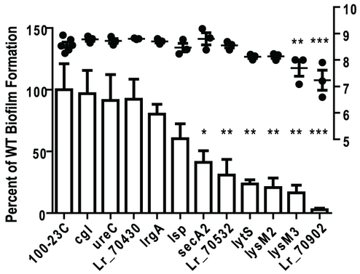
An example:
How does sample size vary with the ratio of a outcome between two groups:
(To use ratios, I did the power calc on a log-scale as the data looked multiplicative)

Slide 59
Examples and Exercise 7: pwr.t.test() function to calculate power and sample size using R.
Power by simulation in the breads example.
Or it can be done analytically with simple formula implemented in R.
https://www.youtube.com/watch?v=ZEFSUm6JNQ0

Slide 60
Cohens d
It should be obvious now that what really matters for power is the ratio of the effect size to the standard deviation
(Because I could just change the units of the true difference and sd)
This is called ‘Cohens d’ statistic or ‘standardised effect size’.
Sample size calculation software will often use this as an input instead of needing both effect size and standard deviation.

Slide 61
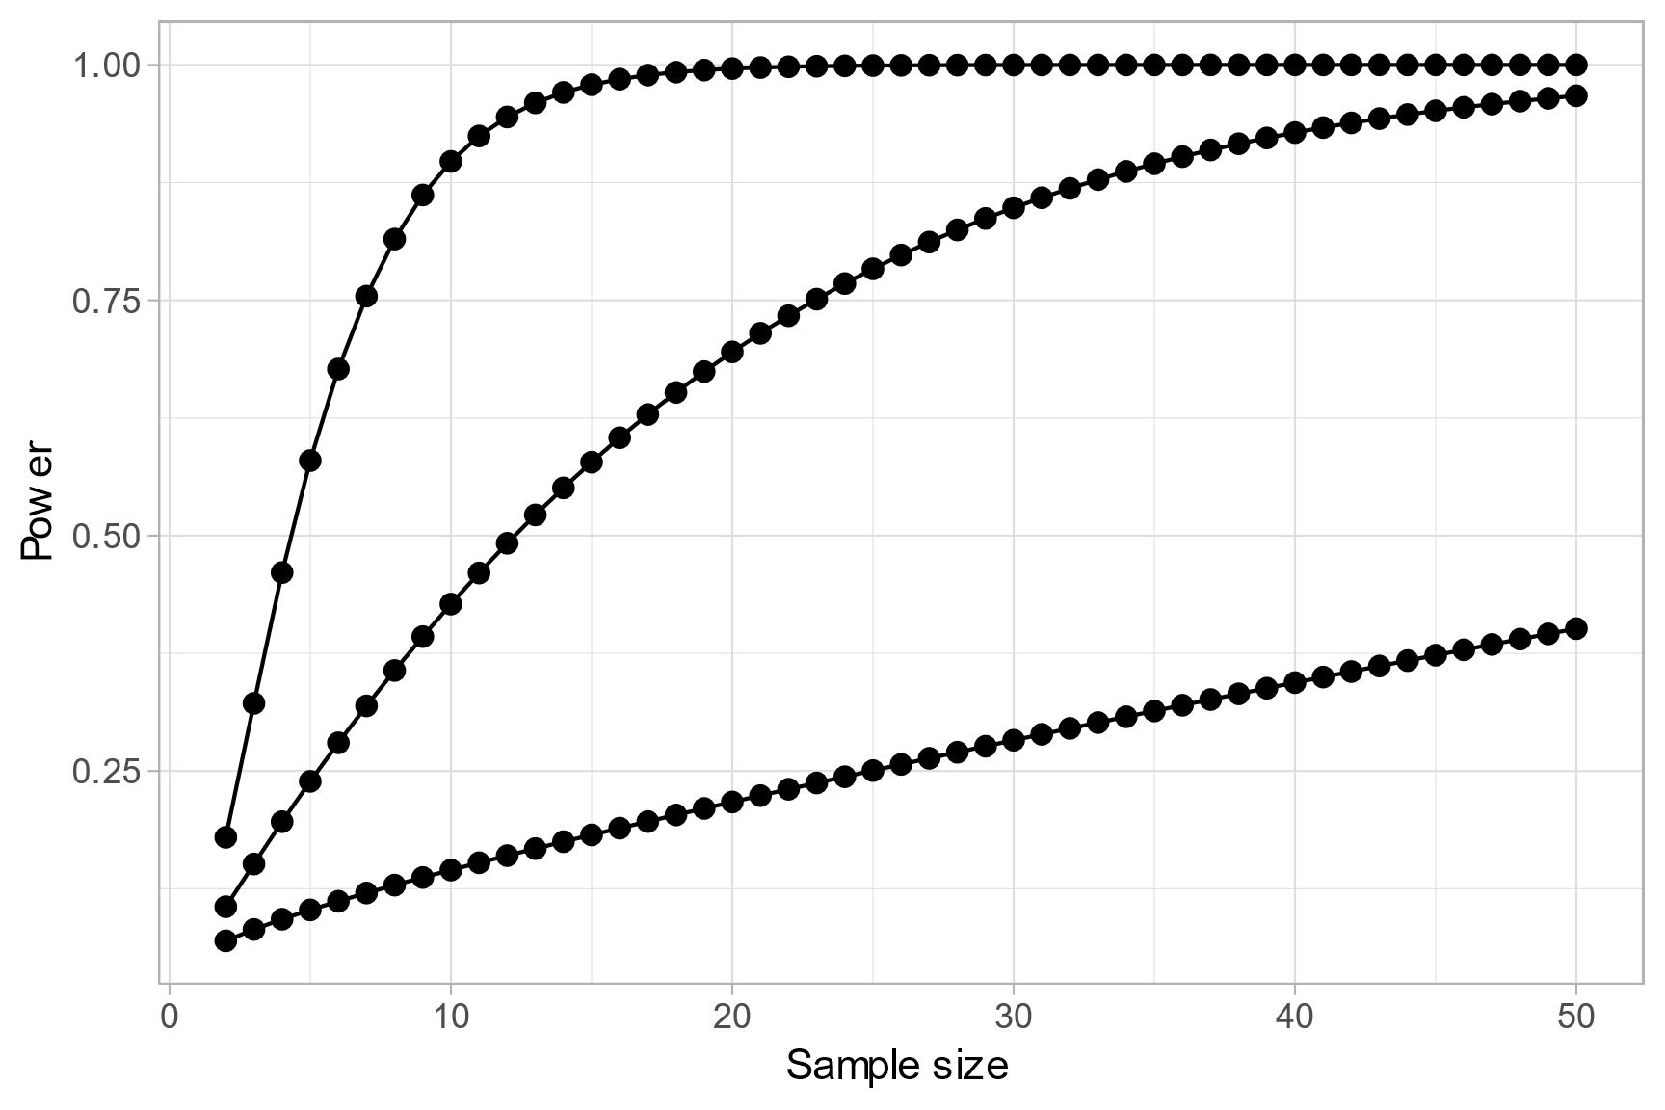
Power curves
For a given effect size and design, we can plot power against sample size. This is a power curve of a study:
Power curves for one sample
one-sided t tests
Cohen’s d=1.0
Cohen’s d=0.5
Cohen’s d=0.2

Slide 62
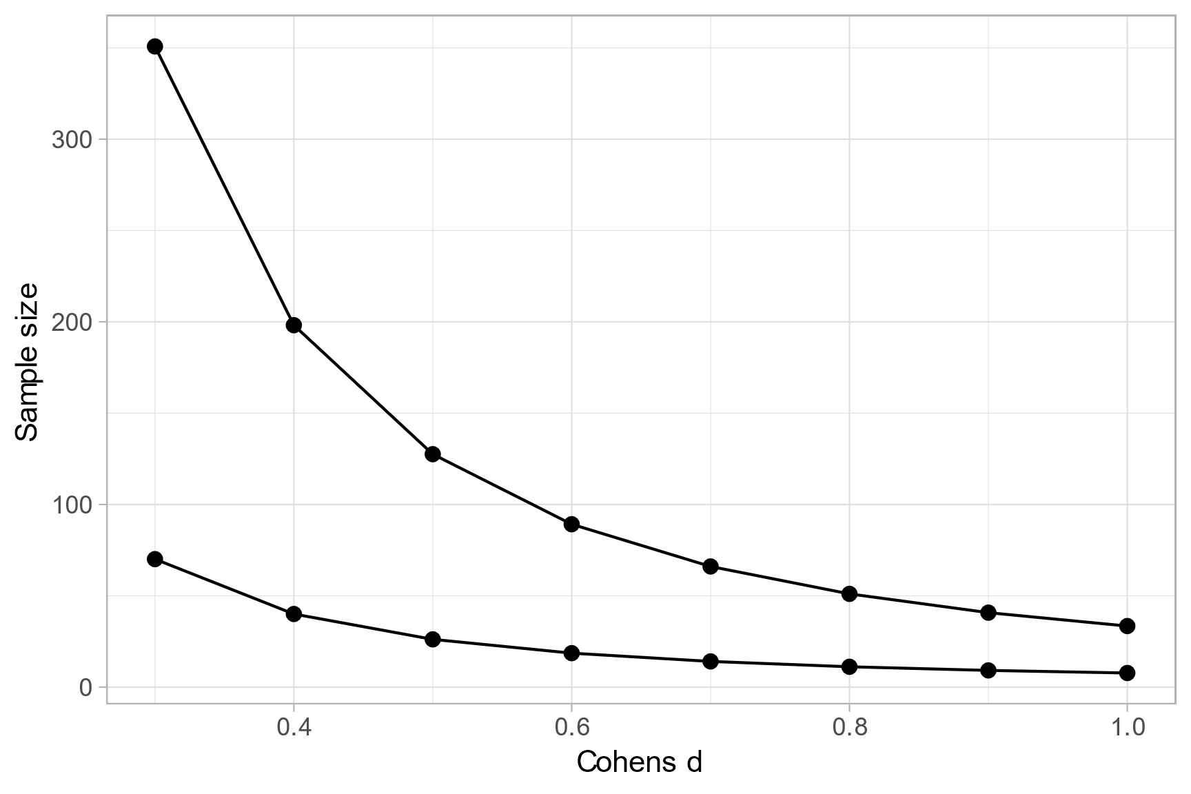
Power curves
Or we could plot the smallest effect size detectable at (say) 80% power and 5% size against the sample size.
Exercise:
Typical animal study?
What is the smallest detectable effect size with N=10 per group in a parallel groups design?
Two-sample, two-sided
One-sample, one-sided

Slide 63
Summary Power and sample size calculations in practice
To get sample size specify: (for a given design, and test)
Effect size, (variance between groups)
Variance of outcome measure, (variance within groups)
P-value (size) (or some other measure of false positive eg false discovery rate)
Power
To get power:
design, effect size, variance, p-value (size) and sample size
To get minimum detectable effect size:
design, variance, p-value (size), sample size and required power
For a given design: with any three of these we can calculate the fourth
Power
(probability of detecting effect if real)
Standardised Effect size
(Cohens d or Cohens h etc)
Risk of false positive
(size or FDR)
Sample size
(experimental units)

Slide 64
Computational approaches
Analytical calculations (eg G*Power, R, ‘pwr’, ‘superpower’ etc packages)
For most simple designs these are usually available.
Or online apps
Simulation (eg R ‘simr’ package, or code it yourself for flexibility)
For more complex designs you can estimate power by simulation
Gives you greater control / understanding, but sometimes harder to do

Slide 65
Standardised effect sizes: eg Cohens d, Cohens h
From exercise: for this design all that matters is:
effect / s.d.
(Standardised) effect size
Standardised mean difference (SMD)
Cohen’s D statistic
(Signal to noise ratio)
Exercise 8:
Cohen’s H statistic for comparing two proportions
ES.h() function from pwr package in R will give you the corresponding ‘effect size’ for comparing two proportions
ES.w1() and ES.w2() for chi-squared comparisons.

Slide 66

Video! Choosing the effect size Daniel Lakens on power and sample size
https://www.youtube.com/watch?v=Lr-i4Ugoc5M
https://www.youtube.com/watch?v=XhfkodpyIsw
Also see Lakens’s ‘statistical inferences’ on Coursera

Slide 67
But my study isn’t just a simple two-mean or two-proportion comparison…
OK – but it’s possible we can:
Reframe the main hypothesis in this way,
Find an analogous approach and package for your design
Or apply a simulation to find the right number
But the logic is the same!
Under reasonable assumptions, will I be able to estimate my effect with enough power/precision

Slide 68
Using common sample sizes from previous work
OK if
Sample size in previous work is properly considered
Common in medical work, less common in bench or animal work
Your outcome measures, goals and populations are similar
Will still need careful justification
Not OK if
Just comes from habit with no rationale
In a field where sample sizes are usually too small
Your outcomes are different, or your population is very different

Slide 69
Where do I get my inputs?

Slide 70

The elephant in the room
All this depends on knowing stuff we don’t know
What is the variance of your outcome measure going to be?
What is the size of the effect you are trying to estimate?

Slide 71
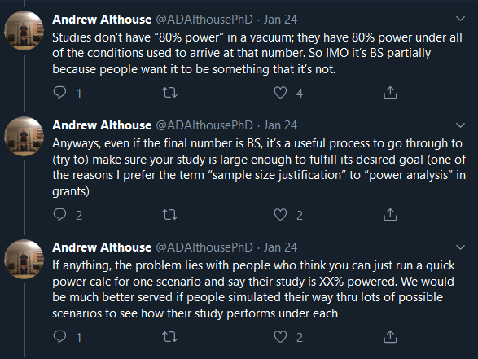
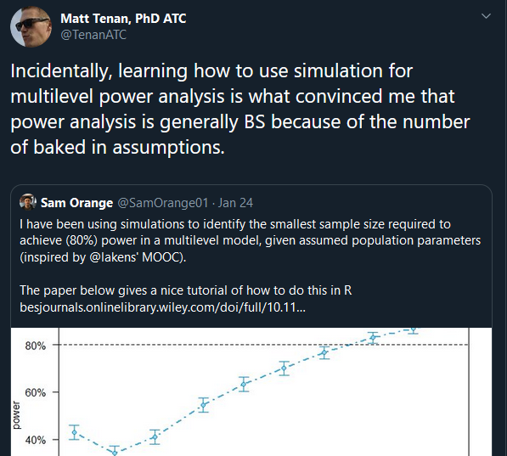
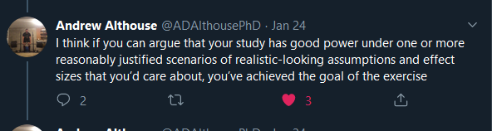
A hot take

Slide 72
Two main things we need to know
What size effect do we want to be able to detect.
How much noise (variance)
Standard deviation of outcome measure
SD of change scores (paired)
SD of outcome (unpaired)
ICC or error structure
Typically from prior data (yours or others)
Minimum important difference
Plausible effect size
Typically from theory / business case / decision
May come from prior work
I can’t tell you this!!

Slide 73
Getting variances
To find the power curve for comparison of means, or to estimate the precision of a mean estimate we need to know the variances of our outcome measures.
Standard deviations = ??
Within / between clusters (eg cages/blocks)??
For longitudinal study: Pre-post correlation = ??

Slide 74
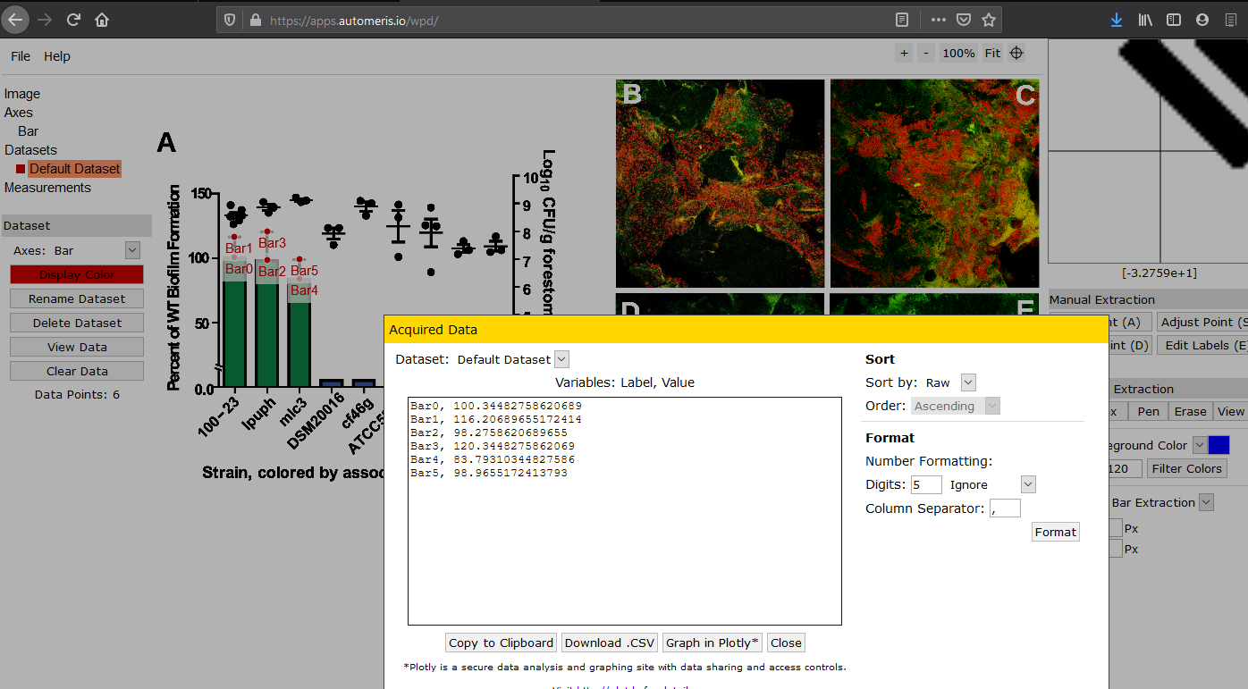
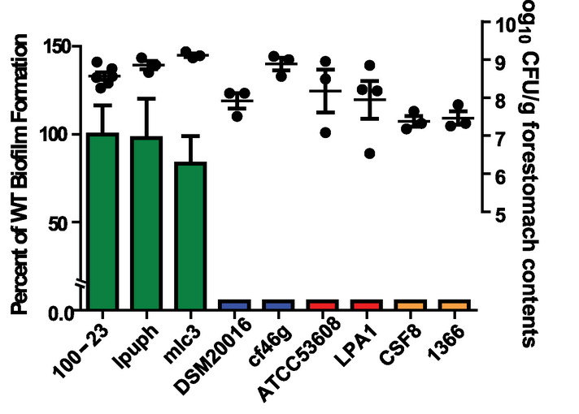
Extracting variances from biology papers

Slide 75
Where does variance data come from?
Your pilot data
From your own lab
You know exactly how it was obtained
Previous studies
Pragmatic
May not be clear how it was calculated
May not be the same measures
May not have reported in the right form
Published measurement work or similar data
Useful if available
Correct populations or specific measures might not be applicable
Developers specifications
Advertising so usually ‘best case scenario’
Under-estimate of variances
Directly applicable
But often small and so imprecise.
Often small samples and poorly reported
You may need to convert the right se’s or IQRs to sd’s.
Possibility of bias if you only focus on ‘positive’ pilots

Slide 76
Eg – Dietary fibre intake study
Designing an intervention to promote fibre intake.
Two sources of prior data on likely variance of within patient pre vs post difference:
Two prior studies: (similar interventions and populations but different tool for measurement)
– can calculate from reported s.e. that s.d. = 10g/day, 7g/day
National survey data: (same tool, different setting)
– can directly calculate that measure has s.d. of 5g/day
So supplied power and sample sizes for:
sd=5g (best case), sd=7g (likely), sd=10g (worst case)

Slide 77
Your own research questions
What is a study you are planning?
What is the outcome?
Where might your prior data on the variance come from?

Slide 78
What effect size to focus on?
If we can get our power curve, we know the risk of failure for each ‘true’ effect size.
How do we choose the effect size for our sample size calculation?
Two approaches commonly used:
Smallest difference of practical interest
Best guess at ‘true’ effect / plausible effect
What can we learn from ANDROMEDA-SHOCK trial?
Too small because they focussed on ‘best guess’ rather than ‘smallest important difference’

Slide 79
Bread trial example: (stakeholders)
Doctor: “It would only have a clinical benefit for a patient if it reduced iAUC by 20 units or more.”
Researcher: “My pilot study suggested a 50 unit difference!”
Marketing Dept: “I don’t care how different it is, so long as I can say its ‘better’ people will buy it!”
What effect size do we power for??

Slide 80
Researcher:
I just want to find the differences! How many samples do I need!
This question isn’t answerable.
Small differences will only be detected with a big sample size.
Big differences can be detected with a small sample size
We can provide the relationship between the smallest detectable difference and sample size.
So you need to know what your target smallest detectable difference is, or the size of the smallest difference you are willing to miss.

Slide 81
ANDROMEDA-SHOCK trial
What kind of difference would be clinically important?
Enough to: change practice given cost etc of the intervention, teach us something that would move us forward etc
In biomedical science the smallest such difference is the MCID
Think about an experiment you are planning. What is the Minimum Important Difference, or other minimum important effect? How can you work this out?
Minimum Clinically Important Difference

Slide 82
Which effect size
Our best prior guess at the true effect size is probably not so relevant..
.. except if we think the true effect is smaller than the MCID then…
…WHY ARE WE DOING THE STUDY???
For sample size calculation, the MINIMUM IMPORTANT EFFECT SIZE is (clearly?) the one we should use.
This is helpful as its up to us what this is (unless there are published estimates around)

Slide 83
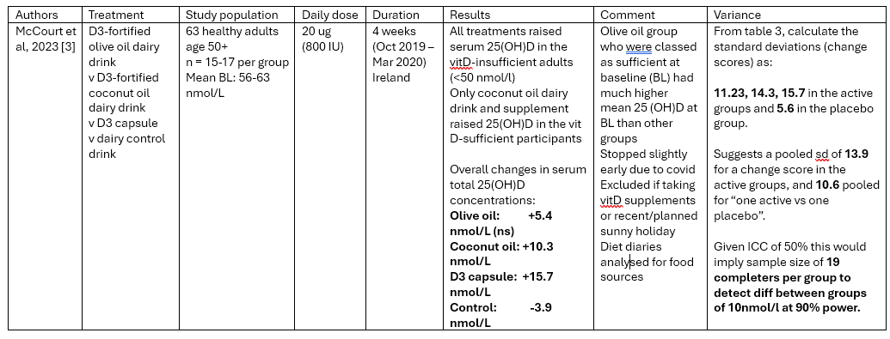
An example (not in the notes)

Slide 84
Efficient designs
Factorial designs / Adaptive designs

Slide 85
Factorial designs
 | Male | Female | Average
Treatment A | 10 (N=8) | 22 (N=6)
Treatment B | 4 (N=8) | 15 (N=6)
Average | Effect=6 | Effect=7 | Effect=6.5 (df=28-3=25)
If you have more than one predictor / treatment
Or you want to improve generalisability
Consider crossing factors, then applying 2-way (or m-way) ANOVA
Or regression analysis
More efficient than the old fashioned “vary one thing at a time” approach
We can test the overall treatment effect, the overall sex effect, and the interaction (whether the treatment varies by sex).
We don’t need to substantially increase the overall sample size compared to a simple 2-group comparison.
2-way ANOVA removes the variance caused by the sex difference!
Shaw et al (2002) https://pubmed.ncbi.nlm.nih.gov/12391398/

Slide 86
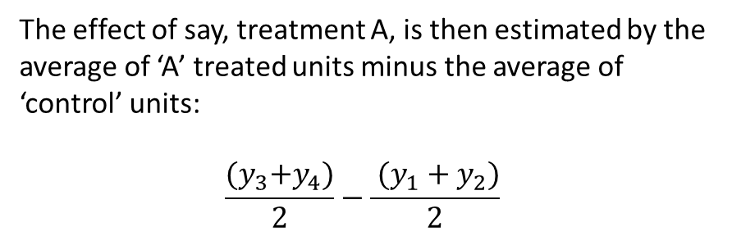
A common design
Suppose we want to know the effect of three different treatments (A,B and C) to a control condition on an outcome
A common experimental design is to create say 8 experimental units, and assign equal numbers to receive each experimental treatment
Common obvious design
Then measure the outcome $y_{i}$ on each unit.
Obs. | Ctrl | A | B | C
1 | + | - | - | -
2 | + | - | - | -
3 | - | + | - | -
4 | - | + | - | -
5 | - | - | + | -
6 | - | - | + | -
7 | - | - | - | +
8 | - | - | - | +
The effect of say, treatment A, is then estimated by the average of ‘A’ treated units minus the average of ‘control’ units:
$$\frac{{(y}_{3}+y_{4})}{2}−\frac{ (y_{1}+y_{2})}{2}$$
So only four units are contributing to each effect estimate!

Slide 87
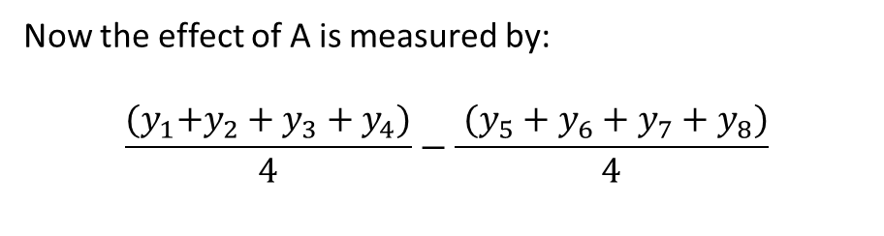
The factorial design is much more efficient
Suppose instead we’d treated our units as follows:
Now the effect of A is measured by:
$$\frac{{(y}_{1}+y_{2}+y_{3}+y_{4})}{4}−\frac{ (y_{5}+y_{6}+y_{7}+y_{8})}{4}$$
Obs. | A | B | C
1 | + | + | +
2 | + | + | -
3 | + | - | +
4 | + | - | -
5 | - | + | +
6 | - | + | -
7 | - | - | +
8 | - | - | -
All 8 units are contributing to the estimate for each treatment (instead of 4 from previous experiment)
We have effectively doubled our sample size from the previous design for free!!
The precision of the estimate of A effect in this design will be much more precise than with the previous design.

Slide 88
Are the treatment effects confounded by each other?
Consider estimating the effect of (say) treatment B. How are treatments A and C divided over levels of treatment B?
Obs. | A | B | C
1 | + | + | +
2 | + | + | -
3 | + | - | +
4 | + | - | -
5 | - | + | +
6 | - | + | -
7 | - | - | +
8 | - | - | -
 | B | Not B
A present (%) | 2/4=50% | 2/4=50%
C present (%) | 2/4=50% | 2/4=50%
Treatments A and C are both perfectly balanced over levels of treatment B. So there is no confounding.

Slide 89
What if the treatment A effect depends on the level of treatment B
Obs. | A | B | C
1 | + | + | +
2 | + | + | -
3 | + | - | +
4 | + | - | -
5 | - | + | +
6 | - | + | -
7 | - | - | +
8 | - | - | -
It might be a concern that the effect of treatment A will depend on whether treatments B and C are present or absent.
This is true, but :
If the effect of A does depend on B, then the factorial design allows us to test that! We can then provide estimates for the effect of A with or without B if they differ.
That is, we can test interaction effects between the treatments.

Slide 90
Adding even more treatments without increasing total sample size
Obs. | A | B | C | D | E
1 | + | + | + | + | +
2 | + | + | - | + | -
3 | + | - | + | - | +
4 | + | - | - | - | -
5 | - | + | + | - | -
6 | - | + | - | - | +
7 | - | - | + | + | -
8 | - | - | - | + | +
This is a ‘fractional factorial’ design because now not every possible combination of treatments is represented.
We can still estimate all five main effects, but some main effects are confounded with interactions (here D is cofounded with AB interaction).
So for this design we would need to assume no AB interaction effect.

Slide 91
Summary – factorial designs
The factorial design is extremely efficient when comparing the effect of several different treatments, saving you resources (eg using fewer animals) or increasing precision.
It also allows for testing of interaction effects that would not otherwise be possible.
Clearly it is not always appropriate or possible, but should be considered whenever an experiment aims to estimate the effect of more than one intervention.

Slide 92
Further reading
Use of Factorial Designs to Optimize Animal Experiments and Reduce Animal Use Robert Shaw, Michael F. W. Festing, Ian Peers, Larry Furlong ILAR Journal, Volume 43, Issue 4, 2002, Pages 223–232, https://doi.org/10.1093/ilar.43.4.223
https://en.wikipedia.org/wiki/Factorial_experiment
Lazic S (2016) Experimental Design for Laboratory Biologists: Maximising Information and Improving Reproducibility. Cambridge University Press

Slide 93
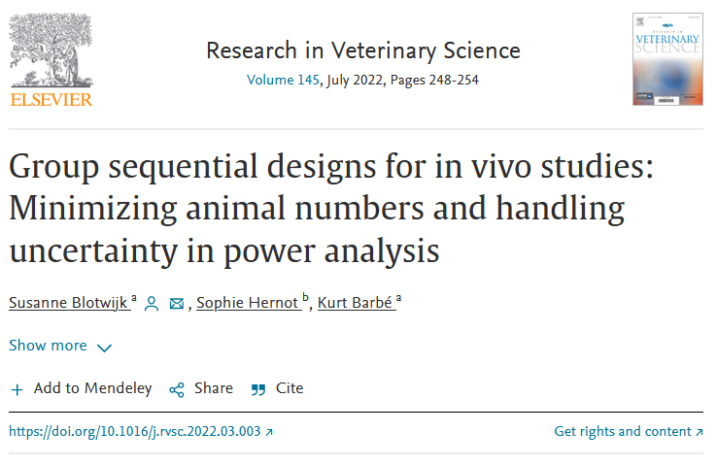
Adaptive ‘Group sequential’ designs
https://www.sciencedirect.com/science/article/pii/S0034528822000741

Slide 94
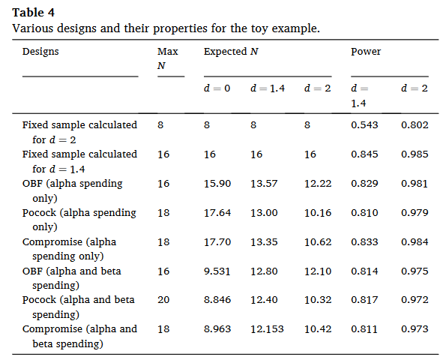
Group sequential design can be more efficient
We can stop early if we prove things to our satisfaction one way or another.
Common in human studies. Not a QRP if pre-registered and p-value adjustments made
Start
N=16
Final Analysis
(p<0.05)
Traditional
(p<0.05)
Start
N=6
Interim analysis
N=6
Interim analysis
N=6
Final Analysis
Group sequential
(set thresholds to control overall Type-1 error at 0.05)

Slide 95
Other considerations

Slide 96
Sample size calculation as risk assessment
All studies are limited by their sample size
Studies have a smallest detectable effect size at a given size and power.
If the real effect is smaller than this you run a high risk of missing it.
Key questions: are you happy with this risk (as an investigator / funder?)
How important is it if we do miss a true effect?
How likely is it to happen (1-power)
Consider clinical/scientific importance and how likely this is to be true

Slide 97
Keep in mind.
Suppose we power based on an effect size of X
Then, if the true effect is less than X, there is a good chance we’ll miss it.
This is a risk you must accept as investigator!!
Reminder questions:
How important would it be? How feasible is it?

Slide 98
Incomplete data
Sample size recruited N=100
Not every sample will give you usable data
Be realistic with your expectations re:
Drop outs
Failures to collect data
Outliers you might need to exclude
Etc..
Increase your sample size by 10-20%?
Dropped out / died
N=80
Incomplete data / technical error
N=75
Crazy outliers
In the analysis:
N=72

Slide 99
Writing up a power calc.
“Our primary aim is to compare glycaemic index between wild-type and mutant breads, using a parallel groups trial of healthy adults
Previous studies have consistently shown that GI has a standard deviation of 20units in similar populations (citations)
We consider 10 units to be the smallest meaningful difference in GI between breads (citations), and with 50 patients per group our study we will have 80% power to detect a difference of this size
We will recruit 60 patients per group to allow for drop-out”
What was your objectives (comparison and outcome measure)
What were your inputs and why
What is your design/analysis plan
What is the power at your given sample size
What other assumptions have you made?

Slide 100
Copying previous research
Is it OK to use a sample size because a previous study did it?
In general – no.
Previous studies are very often vastly underpowered.
If they found a significant effect, they could have been very lucky.
But…
If we see a previously well designed study with good power calc.
and our outcome/MCID is the same
and our design is the same
and our population is the same
Then our minimum sample size should be similar

Slide 101
Rules of thumb
Everything in triplicate
Assumes that there is no variance in response to intervention, differences will be clear cut,
Only replicating to rule out a freak technical error.
If there is known variation in your outcome that is a similar magnitude to your effect size, then not sufficient.
Replicating experiments is weird – do larger blocked experiments instead.
Mead’s Resource Equation
Mainly applied to animal research where no inputs are available.
Suggests keeping the residual degrees of freedom above a certain quantity.
Would be an improvement on many current justifications but..
probably best avoided – if you don’t have good inputs, do a pilot study first.

Slide 102
Session 3
Repeated measures and other complex error structures

Slide 103
Different designs – same basic ideas – you’ll need to read up for your own design
Design | One group | Cross-over study | Parallel groups trial | Randomised block design | Longitudinal study | ‘omics
Test | One-sample t-test | Paired t-test | Two sample independent t-test | ANOVA | Linear mixed regression model | Exploratory multivariate analysis
Effect size | Mean of outcome in sample | Difference in outcome within pairs | Difference between groups | SS_{group} Difference in means between specific treamnets | b coefficient of interest | Log fold-change, Odds ratios
Variance | S.d. of outcome | S.d. of differences within pairs | s.d. of outcome within group | SS_{error} | s.d. of error terms at each level | S.d. of each feature
Or (effect / Variance ratio) | Cohens d | Cohens d | Cohens d | F-statistic / d.f. | -
Size | p-value |  |  |  |  | False discovery rate
Power | 1 - Type 2 error rate |  |  |  |  | Average power / sensitivity
Software | R pwr.*.test() / G*Power / etc |  |  | G*power pwr.anova.test R superpower | R simr (simulation) | Bioconductor packages

Slide 104
Sample size justifications for more complex designs or questions
Ultimately all power calcs are an extension of the simple estimation / testing ideas shown previously.
Either
Reduce the problem to a simpler one (find a simple key hypothesis you want to be able to test)
Make a suitable calculation given your expected variance / expected precision / expected effect size
Simulate based on real data, adding an effect and testing how often you can detect it.

Slide 105
Two extensions to our basic power calc:
Non-independent observations
(complex error structure)
Simple comparisons of means, proportions etc
Multiplicity
(lots of outcomes)

Slide 106
Complex error structure Repeated measures, pairing, clustering etc..
How and why does changing the error structure of an experiment change the nature of a sample size calculation?
Error structure:
What is the source of the variation in your outcome?
How is this distributed among the experimental units?
Eg
What factors affect a mouse microbiome?
Which factors are specific to the animal, and which are shared with its litter mates, co-housed mice, etc..

Slide 107
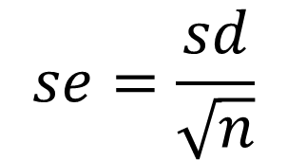
Error structure
Everything so far assumes samples are independent of one another.
Possible violations of independence assumption:
Repeated measures from the same patient
Patients coming from the same household
Mice from the same cage, images from the same mouse, observations from the same image
Genes from closely related bacterial strains
‘Paired’ designs where a paired t-test might be appropriate
Etc??
Good and bad implications:
The good: Comparing within clusters - we can ignore the shared variation (more precise)
The bad: Comparing between clusters - we have effectively fewer samples (less precise)
$$se=\frac{sd}{\sqrt{n}}$$
Only true if observations are independent!!!

Slide 108
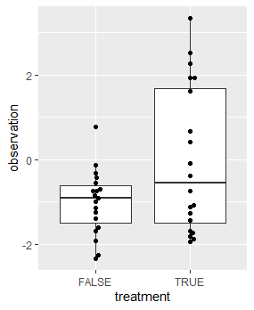
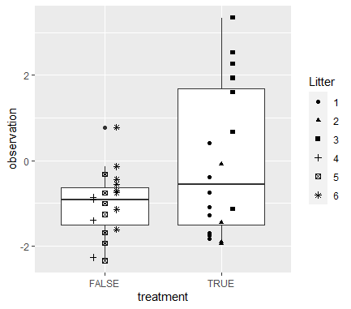
Example: Analysis of a treatment effect
(Simulation closely following some real QIB data)
p-value = 0.02836
p-value = 0.438

Slide 109
Good and bad implications of clustered data
Pseudoreplication affects sample size calculations as well as analyses
Suppose mice within cages are more similar than mice between cages:
Same litter or cage-specific exposures
If experimental conditions are varied within cages/clusters
Comparisons within cage – smaller variation – smaller sample size needed!
Analogous to paired tests
If experimental conditions are varied between cages/clusters
The cage is the experiment unit not the mouse.
You’ll likely need more mice than if they could be housed independently

Slide 110
Treatments varying between clusters
Clustering and design effects decrease power and precision

Slide 111
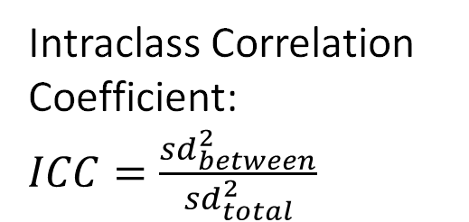
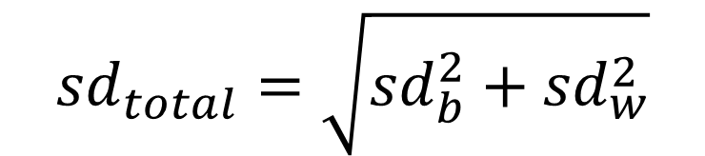
Error structure (clustering)
$${sd}_{total}=\sqrt{{sd}_{b}^{2}+{sd}_{w}^{2}}$$
Variance within
cages
sd_{within}
Variance between cages
sd_{between}
Mouse 1
Intraclass Correlation Coefficient: $ICC=\frac{{sd}_{between}^{2}}{{sd}_{total}^{2}}$
Cage 1
Mouse 2
Mouse 3
Mouse 4
Mouse Population average
Cage 2
Mouse 5
Mouse 6
How many ‘independent’ observations have I got to estimate the population mean?
3
9
Depends on the ICC
Mouse 7
Cage 3
Mouse 8
Mouse 9

Slide 112
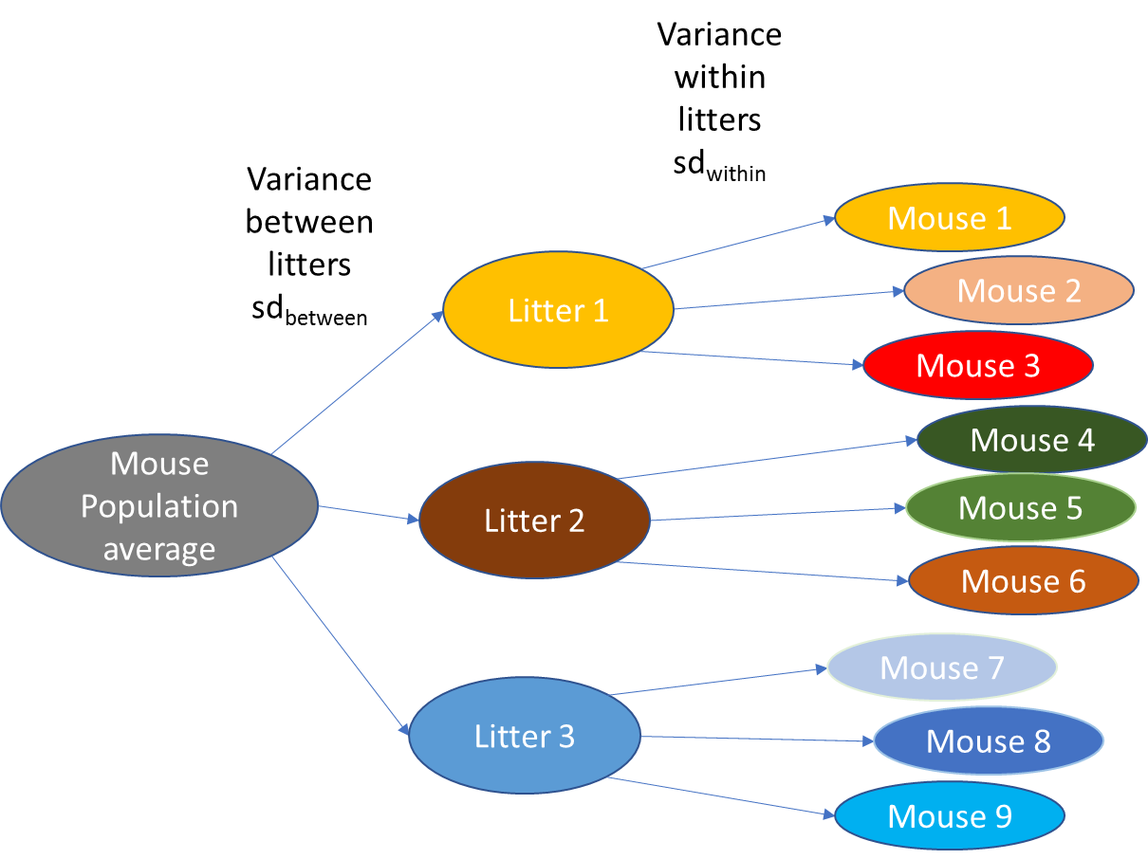
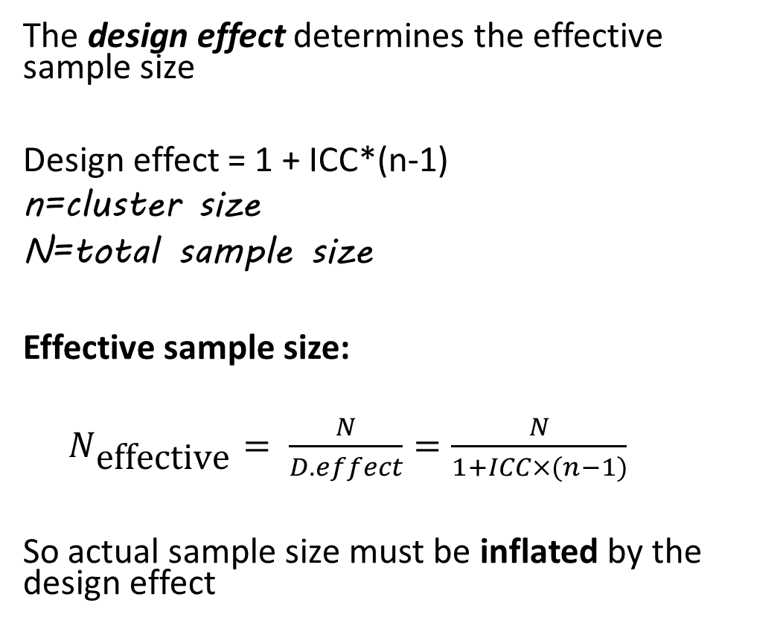
Effective sample size and design effect
The design effect determines the effective sample size
Design effect = 1 + ICC*(n-1)
n=cluster size
N=total sample size
Effective sample size:
$N_{\text{effective}}= \frac{N}{D.effect}=\frac{N}{1+ICC×(n−1)}$
So actual sample size must be inflated by the design effect

Slide 113
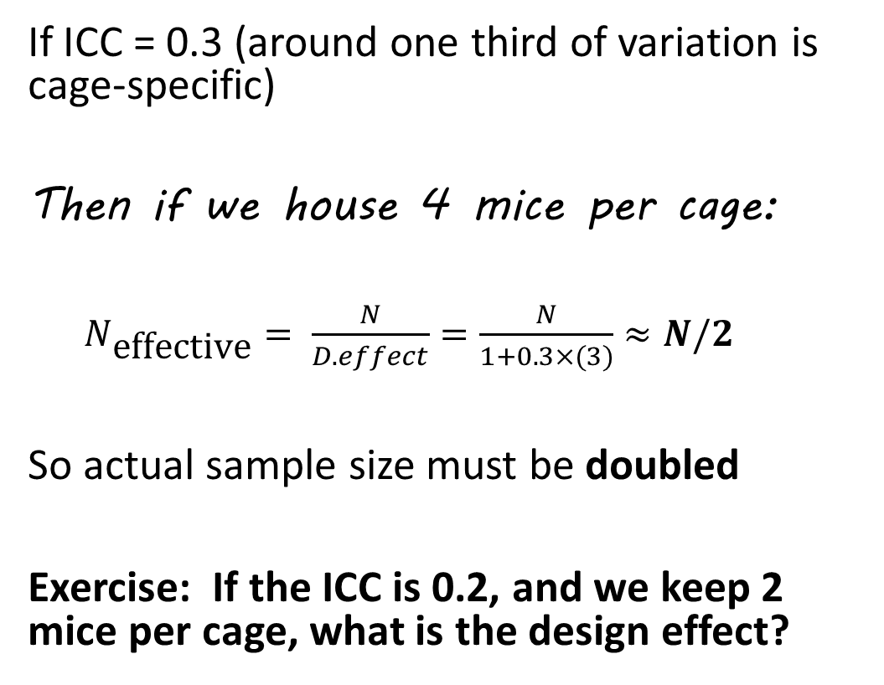
For example
If ICC = 0.3 (around one third of variation is cage-specific)
Then if we house 4 mice per cage:
$N_{\text{effective}}= \frac{N}{D.effect}=\frac{N}{1+0.3×(3)}≈N/2$
So actual sample size must be doubled
Exercise: If the ICC is 0.2, and we keep 2 mice per cage, what is the design effect?

Slide 114
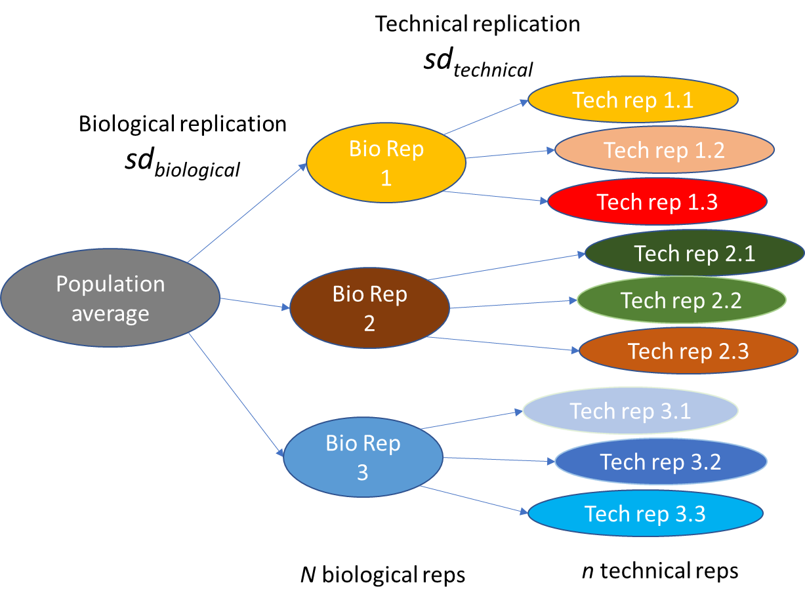
Technical and biological replicates
So.. What is a biological replicate?
What is a technical replicate?
We might have several levels of replication and sources of variation
Calling these levels ‘biological’ or ‘technical’ replicates is probably an over-simplification a lot of the time, but fits our purposes often.
Linear mixed models can help with more general scenarios

Slide 115

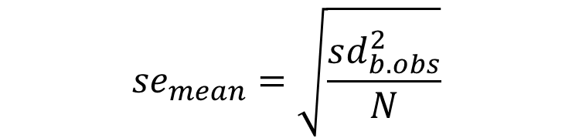
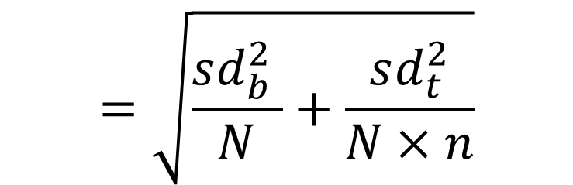
Biological and technical replicates
Consider an experiment to estimate a population average:
What is the standard error of the estimate of population average?
$${se}_{mean}=\sqrt{\frac{sd_{b.obs}^{2}}{N}}$$
“Law of total variance”
$$=\sqrt{\frac{sd_{b}^{2}+\frac{sd_{t}^{2}}{n} }{N}}$$
$$=\sqrt{\frac{sd_{b}^{2} }{N}+\frac{sd_{t}^{2}}{N×n}}$$
So should you increase biological or technical reps?

Slide 116
Mouse studies and power
Lets suppose we are planning a mouse study
How does the power change with the allocation of mice to cages?
Artificial microbiome heterogeneity spurs six practical action themes and examples to increase study power-driven reproducibility
Basson et al Scientific Reports volume 10, Article number: 5039 (2020)
https://www.nature.com/articles/s41598-020-60900-y

Slide 117
Treatments varying within clusters
Pairing / stratification / cross-overs increase power and precision

Slide 118


Pairing observations and precision in the bread study
Part. 1
WT
WT
Participant 1
Part. 2
WT
MT
Human population
Human population
Part. 3
MT
WT
Participant 2
MT
sd_{between}
Part.4
sd_{between}
MT
sd_{within}
sd_{within}
$$se=\frac{\sqrt{2}×{sd}_{total}}{\sqrt{n_{(per group)}}}$$
$$se=\frac{\sqrt{2}×{sd}_{within}}{\sqrt{n_{(participants)}}}=\frac{{sd}_{difference}}{\sqrt{n_{(participants)}}}$$

Slide 119



Sample size and paired observations
So to find sample size to achieve a given precision you have to know or find:
s.d. of outcome within people
or
s.d. of difference between measures within people
or
Total s.d. across individuals and ICC
Note here – ICC helps not hinders
Sample size based on power calculations works similarly.
$$n=\frac{2×{sd}_{within}^{2}}{{se}^{2}}$$
$$n=\frac{{sd}_{diff.}^{2}}{{se}^{2}}$$
$$n=(1−ICC)×\frac{2{×sd}_{total}^{2}}{{se}^{2}}$$
In pwr.t.test: https://stats.idre.ucla.edu/r/dae/power-analysis-for-paired-sample-t-test/

Slide 120
Demonstration: paired test with R
Exercise 9 – Cross over study
Use R to find the sample size for a cross-over study compared to an unpaired study for the breads example.
Assume the variance is split 50:50 between and within participants:
A sd_total of 60 would correspond to an sd_within of 42.
So standard deviation for difference in one individual is 60!
By using the same units twice we need a quarter of the total units, and do half as many tests as for the parallel groups study.

Slide 121


Demonstration: paired test with R and G*Power
Assume no pre-post correlation (ICC=0)
pwr.t.test(d=10/(20*sqrt(2)),
n=NULL, power=0.8, type="paired")
Paired t test power calculation
n = 64.73788
d = 0.3535534
sig.level = 0.05
power = 0.8
alternative = two.sided
NOTE: n is number of *pairs*
Assume ICC = 0.5
pwr.t.test(d=10/(20*sqrt(2)*sqrt(0.5)),
n=NULL, power=0.8, type="paired")
Paired t test power calculation
n = 33.36713
d = 0.5
sig.level = 0.05
power = 0.8
alternative = two.sided
NOTE: n is number of *pairs*

Slide 122
Other more complex designs
Blocked experiments
Longitudinal studies
Will be similar in approach.
You need to know the error variance at each level (between/within/over time etc).
May be too complex for analytic studies
Simulation studies can be very insightful to understand how your study will perform
Eg simr package in R for longitudinal modelling – based on mixed models
superpower package for repeated measured ANOVA designs

Slide 123
Session 4
Power and sample size for
multiple endpoints,
‘omics studies,
more complex analyses

Slide 124
Multiplicity
Family wide error rate control:
Bonferroni, Holm, et al
As the number of outcomes goes up……
…..so does the number of tests…..
…..the chance of false positives goes up…….
…..we (should) correct by using stricter p-values for each test…….
……stricter p-values means lower power for each comparison.
False discovery rate control
Benjamini and Hochberg et al

Slide 125

How does sample size change with number of outcomes?
If Bonferroni correction: For N outcomes, critical p divided by N:
(we can easily change p in power.t.test() to find out)
For example, if we need ~60 for one outcome…

Slide 126
‘Omics studies
Characterised by:
Often a single outcome measure (phenotype)
Many (hundreds/thousands) of possible predictors
Each considered equally
Hence many hypotheses being tested
FDR or very low critical p-values to make discoveries
Possibly multivariate analysis (eg PCA) for dimension reduction
Difficult to set an ‘important’ effect size to detect…

Slide 127
False discovery rate and q-value
“…we reported features identified as significant at q<0.05 (Benjamini and Hochberg)”
What does it mean? Where does the q-value come from?
Suggested reading:
‘qvalue’ vignette.
http://www.nonlinear.com/support/progenesis/comet/faq/v2.0/pq-values.aspx

Slide 128
Power for ‘omics study
Probability of detecting a difference in any particular feature, while controlling the number of false positives:
Analogous to size: fix the rate of false positives you are willing to accept (FDR)
Analogous to power: proportion of true positives you want to be able to detect (average power)
Set a target effect size (Cohen’s d) for detection of each feature
Make sure your design matches the design being applied by the sample size calculator.

Slide 129
Approaches to multiplicity
First: be as targeted with hypotheses as is possible
If not possible, or in addition, select a ‘Family Wide Error Rate’ or ‘False Discovery Rate’ approach to type I error.
FDR: the proportion of discoveries that are false is (say) q<0.05
FWER: the probability of making at least one false positive discovery is (say) p<0.05
Applies to exploratory ‘omics’ research and all other multiple outcome studies

Slide 130
Gene expression microarray analysis / Differential abundance analysis
Very small sample size, many quantitative measures per sample.
One or more phenotypes and treatments, many different designs possible
Aim: Identify which genes/OTUs differ between groups
Outcome: Fold change in expression/abundance for each feature
Analysis:
Linear model for each gene expression or OTU abundance (eg edgeR) or non-parametric test (eg Mann-Whitney)
‘FDR’ approach to multiplicity correction for p-values.
Power and sample size:
How do you interpret power and sample size?
What does power mean in this context?

Slide 131
Microarray studies (1)
Several approaches depending on complexity of prior knowledge and study design
Simplest approach:
Assume all genes/taxa have the same s.d.
Fix the expected number of false positives you expect
Choose an acceptable average power for genes
as implemented in sizepower Bioconductor package: equiv. to fixing Cohens’s d to be the same for each gene
Lee, M.-L. T. and Whitmore, G. A. Power and sample size for DNA microarraystudies. Statistics in Medicine, 21:3543–3570, 2002.

Slide 132
From the ‘sizepower’ vignette:
Require power of 90%
Allow: one false positive on aberage
R> sampleSize.randomized(ER0=1, G0=2000, power=0.9, absMu1=1, sigmad=0.566)
$n[1] 8
$d[1] 1.766784
True effect is 1.0
SD of expression is 0.566
2000 not-differently expressed genes
Read the paper or the vignette before you try to apply this!

Slide 133
Microarray studies – (2) a bit more complex
Not every gene will have the same s.d.
S.d.’s are all different implies different sample size needed for each gene.
If we know the s.d.’s from similar work in the same system
then rather than fixing Cohens d, we can fix the target fold change, and look at the proportion of genes we can detect with a fixed level of power.
Implemented by ssize package in Bioconductor.

Slide 134

Proportion of differentially expressed genes detectable at each sample size
From ssize Bioconductor R package
Need to know:
Distribution of standard deviations of log-fold change
‘ssize’ vignette for more details

Slide 135
Microbiome sample size analysis
If you are targeting a small number of parameters
Diversity, richness etc (single continuous variable)
Prevalence of specific species (proportion)
Existence of specific species (binary outcome)
Or by dimension reduction (say comparison of first or second PCs)
Etc..
Then any of the earlier methods (for simple outcomes) apply.
For exploratory differential abundance analysis
Apply a correction (eg Benjamini-Hochberg) to p-value and proceed as above
Or apply the logic of gene expression power calcs (previous slides)
Or use a simulation (next slides)

Slide 136
Benjamini-Hochberg correction
You don’t know the critical p-value threshold until you have the data
But you can make an educated guess at where it will be
Eg:
But if I expect to detect 10 ‘significant’ genes out of say 1000, then to control FDR at 0.05 I will have a critical p-value of
0.05 * 10 / 1000 = 0.0005
I can plug this into my regular power calculation to get a rough expected power.

Slide 137

Casals-Pascual et al (2020) Gastroenterology 158:1524-8

Slide 138
Simulating power calculations for microbiome studies
Similar to our exercises earlier:
Simulate datasets similar to the data you will generate in your experiment:
Make perturbations of the type you want to be able to detect
See what proportion of the changes you can detect at various sample sizes

Slide 139
Two packages for simulating microbiomes for power calc
Systematic review – only four relevant papers presenting methods!
hmp – questionable assumptions
Based on modelling microbe abundances as a Dirichlet-multinomial distribution. La Rosa et al (2012) https://journals.plos.org/plosone/article?id=10.1371/journal.pone.0052078
powmic - https://github.com/lichen-lab/powmic
Chen (2020) Bioinformatics 36(11) 3563-3565
Difficult to extend these to complex designs

Slide 140
Summary – complex designs
There are lots of papers on sample size calculations around for different designs
Make sure you understand what each is doing, and that it matches the problem you are trying to solve, your priorities for your experiment, your design, your analysis plan and expectations about the findings..
Work with me (collaboratively!) on this.
It won’t be perfect but will be a reasonable ballpark guide
Don’t just eg find a ‘microarray’ or ‘microbiome’ sample size calculator and bung in some numbers.

Slide 141
Metabolomics studies
Methods in the literature based on PCA, PLS-DA to discriminate between groups.
Again, mainly based on taking real data, adding a simulated difference, testing to see what the power is.

Slide 142
Session 5 How to need fewer samples

Slide 143
How to reduce required sample size in a research study
Reduce noise in outcome measure
Better outcome measure (more proximal to intervention / less noisy?)
More careful sampling of units, control of experimental parameters (less representative)
Use a more efficient design or analysis
Pairing samples. Consider balance between groups
One sided testing? (must be carefully thought out and justified)
Carefully incorporate pilot data, (use Bayesian analysis to incorporate prior knowledge etc?)
Consider Adaptive design or Sequential testing? Dropping arms when not needed? (https://journals.plos.org/plosbiology/article?id=10.1371/journal.pbio.2001307)
Design properly (use eg an experimental design assistant)
Reduce number of hypotheses being tested
Do fewer studies but do better studies
Avoid needless replication. Build consortia. Apply for realistically large grants.
Be realistic about what you can detect.

Slide 144
Less noise or more effect = fewer samples needed
Reduce noise in outcome measure:
Use an outcome that is more proximal to your intervention? (as phase II drug trials often will use biomarkers rather than clinical outcomes)
Use a composite outcome? Or an outcome that is more reliable? (eg objective vs subjective? Repeat measurements?)
More careful sampling of units, reduce heterogeneity in sample population (at possible cost to generalisability)

Slide 145


Do not dichotomise your continuous measures
https://georgemsavva.github.io/R_for_Statistics/dichot.html

Slide 146
Change your design
Consider pairing, or repeated measures analysis to remove variance (eg cross-over study)
Blocking or minimisation to ensure balance across treatment groups
Carefully Consider whether all groups are really necessary
Might pre-post meet your objective rather than between groups?
Consider using a factorial design rather than multiple arms
Go on the experimental design and analysis course or read a book on design appropriate to your field!

Slide 147
Consider trying to increase the treatment effect:
A larger effect size is easier to detect.
If you’re just trying to show that an effect exists *at all* then inducing the largest possible effect by increasing the treatment, the duration, or by reducing the number of treatment levels might help.

Slide 148
Factorial designs can be more efficient!
Consider testing effect of 2 factors, A and B, with 24 observations:
Factorial design with four groups:
Control, Treat A, Treat B, Treat A+B
Three groups: Control, Treat A, Treat B
Control
N=6
A
N=6
Control
N=8
A
N=8
B
N=8
B
N=6
A + B
N=6
Effect of factor A: A vs control
N=16
We’re wasting the 8 “Group B” observations here!
Effect of treat A:
(A and A+B) vs (control and B only)
All 24 observations used!
50% more data for the same total sample size!

Slide 149
Consider adaptive design (design that changes as we go)
Clinical trials are very resource intensive, triallists have come up with lots of ways to save money but still be robust:
Eg carefully planned group sequential design: (need to adjust p-value threshold to allow possibility of stopping the study early)
N=10
Unsure
N=10
Unsure
N=10
AcceptH0
Reject H0
AcceptH0
Reject H0
AcceptH0
Reject H0

Slide 150
Conduct fewer primary studies
Many studies are a waste of time:
Answering questions we already know the answers to
Answering questions we don’t care about
Generating data or materials we already have elsewhere
Answering questions badly or
Conducting studies that have no hope of meetings their objectives
What might you do?
Start with a systematic review
Speak to users / end users
Use existing data where possible
Pool resources, build consortia to apply for bigger (realistic) grants
Don’t tackle impossible questions

Slide 151

Final words
Extracts from conversations between the scientist and the statistician

Slide 152
“It’s OK if we’re underpowered, the more things we test, the more chance we’ll find something!” - Anonymous RL
Hopefully I don’t need to explain this one?
Success or failure shouldn’t be judged on whether or not you ‘find something’. It should be about how precisely and robustly you answered your original research question.
More tests = more false positives
P-value thresholds must be corrected downward
If you genuinely have a multiplicity of outcomes, plan for this appropriately.

Slide 153
“But we always use N=3!”
Each experiment has its own objectives, its own parameters, its own sources of variance
Copying a previous design without considering your own needs risks underpowering or overpowering

Slide 154
“But [previous work] got p=0.048 with 3 mice! Why do I need 8?”
Previous work is a useful source of information for calculating sample size
But remember: results of scientific experiments are random
Most published work over-estimates effects and under-estimates variance
And If p=0.048 in a previous study, then the power for that study was almost exactly 50%. Can you think why?
So you can conclude the original study was underpowered and they got ‘lucky’ or likely to be a false positive, but in any case, you need more than they did.
(A p-value of 0.005 corresponds to 80% power at p=0.05)

Slide 155
“Its OK, we’ll repeat the experiment to confirm it afterwards”
What are you really doing here? What do you learn from doing this repeat?
Why don’t you believe the first experiment? Fix the issue?
If you repeat an underpowered experiment, your chance of success is low even if the effect is real.
If you repeat a properly powered experiment, then you’ve wasted your time.
By analysing individually you miss out on the benefits of the repeats!
What you are really doing is a weird two-stage design (how do you get your effect estimates?). Difficult to understand the statistical properties of this.
Design it properly to begin with?

Slide 156
The ‘it’s OK we’ll repeat it afterwards’ design
Test 1
Test 2
Success!
☺
p<0.05
p<0.05
Power=80%
(ok but I don’t trust myself)
Power=80%
(well that settles it)
p>0.05
(nothing there)
p>0.05
(must have been a fluke or something)
Failure
☹
Consider what we learnt about repeatability of studies from the first session.
If you have enough samples for two experiments, then run two studies or a proper adaptive design.
What is the power and size of this design?
Power = 64%
Size = 0.0025
Was this the intention?

Slide 157
“I don’t care how different, I just want to show they are different…”
An argument against needing to think about minimum important differences.
Reasonable on the face of it…
But…
…given enough data, null hypothesis is always false
That is, every intervention makes at least some difference to an outcome.

Slide 158
“If we see an effect even in an underpowered study, then it must be real” - me in less enlightened times
Sort of intuitively correct?
But NO!
We have seen that underpowered studies are more likely to throw false positives
A very large observed effect is highly likely to be a false positive if your prior belief is that the true effect is small..

Slide 159

“My grant is due next week, I’m using five mice, can I have a power calculation to justify this?”
Previously: I have misgivings about this but I’ll see what I can do.
In future: No.
When in your project planning process should you think about sample size?
Keep in mind from the earliest stages of planning
Not 2 weeks before a grant deadline when all the costs are already done and you’re up to budget.
Not 6 months into your PhD project – what if it’s not feasible?
But do revisit at those times and whenever design decisions are being taken!

Slide 160
Take home messages
Conducting underpowered studies is a waste of time and resources.
An unethical waste in the case of animal and human studies
Conducting sample size calculation requires you to think through your research questions, design and analysis
Plans are useless – planning is essential
Broadly speaking – sample size depends on:
Your willingness to accept false positives and negatives
At a given ratio of ‘signal’ to ‘noise’ in your experiment.
To detect a smaller signal -> more numbers
With more ‘noisy’ experiment -> more numbers
It isn’t an exact science, so consider a range of inputs
The principle is the same, but is operationalised differently for different designs and research questions.

Slide 161
Thanks
Questions
Feedback

